Slide 1
STAT 7900: Special Topic:
Causal Analysis
Instructor
Dhrubajyoti Ghosh
KENNESAW STATE UNIVERSITY
STAT 7900

Slide 2
From ATE to CATE
$ATE:τ = E[Y(1) − Y(0)]$ vs. $CATE: τ(x) = E[Y(1) − Y(0) | X = x]$
ATE: one summary
CATE: effect heterogeneity
How much does the treatment change the outcome on average across the target population?
Does the treatment effect depend on baseline covariates such as age, risk, or previous earnings?
Key caution: CATE is an average for people with a given X, not an observed individual causal effect.

Slide 3
Classical HTE: The interaction-model bridge
$$E[Y | T, X] = β₀ + β₁T + β₂X + β₃(T × X)$$
Estimated conditional effect: $τ(x) = β₁ + β₃x$
What we gain
What becomes hard
A testable, interpretable treatment-effect modifier.
Many modifiers, nonlinear effects, and unknown interactions.
This motivates flexible CATE learners without manually specifying every interaction.

Slide 4
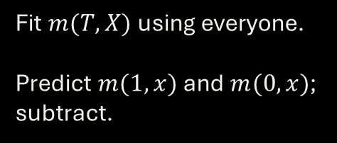
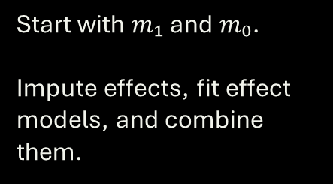
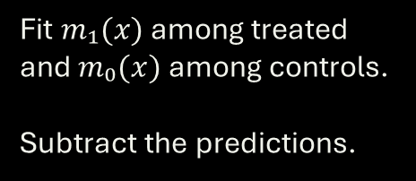
S-, T-, and X-learners: Three workflows
S-learner • single model
T-learner • two models
X-learner • two stages
Fit $m(T, X)$using everyone.
Predict $m(1, x)$and $m(0, x)$; subtract.
Fit $m₁(x)$ among treated and $m₀(x)$ among controls.
Subtract the predictions.
Start with $m₁$ and $m₀$.
Impute effects, fit effect models, and combine them.
None is universally best. All still rely on valid identification assumptions.

Slide 5




X-learner: Recall the pseudo-treatment effects
Among treated $\left(T = 1\right)$
Among controls $\left(T = 0\right)$
$D¹$ = observed $Y$ $−$ predicted $m₀(X)$
$D⁰$ = predicted $m₁(X)$ $−$ observed $Y$
Then fit two models of $D¹$ and $D⁰$ as functions of $X$.
Combine: ${\hat{τ}}_{X}(x) = e\left(x\right) {\hat{τ}}_{0}\left(x\right) + \left[1 − e\left(x\right)\right]{\hat{τ}}_{1}\left(x\right)$
Important: $D¹$ and $D⁰$ are imputed effect proxies, not true observed individual effects.

Slide 6
Comparison: S-, T-, and X-Learners
Feature | S-Learner | T-Learner | X-Learner
Outcome models | 1 | 2 | 2 initial + effect models
Information sharing | High | Low | Intermediate / adaptive
Treatment imbalance | Can be stable | Can struggle | Often attractive
Main idea | Predict both worlds from one model | Separate response surfaces | Impute and learn treatment effects
Main risk | Treatment signal shrunk | Small-arm instability | More modeling stages
None is uniformly best; performance depends on sample size, imbalance, smoothness, and the base learner.

Slide 7
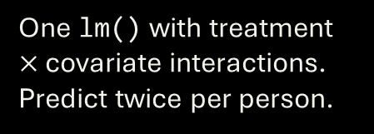
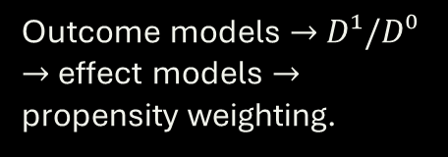
From concepts to R: What will we implement?
S-learner
T-learner
X-learner
One lm() with treatment $×$ covariate interactions.
Predict twice per person.
Separate lm() fits for the two arms.
Predict both potential-outcome means.
Outcome models $→$ $D¹/D⁰$ $→$ effect models $→$ propensity weighting.
install.packages("MatchIt")
library(MatchIt)
data("lalonde", package = "MatchIt")
d <- lalonde
head(d)

Slide 8
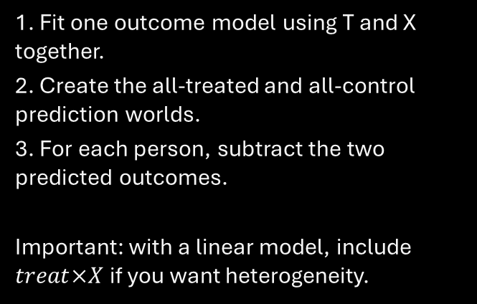
R Code: S-Learner
Code
How to read it
fit_s <- lm(
re78 ~ treat * (age + educ + re74 + re75),
data = d
)
d1 <- transform(d, treat = 1)
d0 <- transform(d, treat = 0)
mu1_s <- predict(fit_s, newdata = d1)
mu0_s <- predict(fit_s, newdata = d0)
tau_s <- mu1_s - mu0_s
summary(tau_s)
1. Fit one outcome model using T and X together.
2. Create the all-treated and all-control prediction worlds.
3. For each person, subtract the two predicted outcomes.
Important: with a linear model, include $treat×X$ if you want heterogeneity.

Slide 9
R Code: S-Learner
Code
How to read it
cate_s <- function(age, educ, re74, re75) {
b <- coef(fit_s)
b["treat"] +
b["treat:age"] * age +
b["treat:educ"] * educ +
b["treat:re74"] * re74 +
b["treat:re75"] * re75
}
coef(fit_s) extracts the estimated regression coefficients.
The treatment coefficient and treatment–covariate interaction coefficients define the estimated CATE function.
Different covariate values can produce different estimated treatment effects.

Slide 10
R Code: T-Learner
Code
How to read it
fit1 <- lm(
re78 ~ age + educ + re74 + re75,
data = d[d$treat == 1, ]
)
fit0 <- lm(
re78 ~ age + educ + re74 + re75,
data = d[d$treat == 0, ]
)
mu1_t <- predict(fit1, newdata = d)
mu0_t <- predict(fit0, newdata = d)
tau_t <- mu1_t - mu0_t
summary(tau_t)
1. Fit a treated-outcome model only among treated units.
2. Fit a control-outcome model only among control units.
3. Use both models to predict for the same person.
4. Subtract the two predicted outcomes.
This allows the treated and control response surfaces to differ.

Slide 11
R Code: X-Learner (Steps 1–2)
Code
How to read it
# Step 1: initial outcome models
fit1 <- lm(re78 ~ age + educ + re74 + re75,
data = d[d$treat == 1, ])
fit0 <- lm(re78 ~ age + educ + re74 + re75,
data = d[d$treat == 0, ])
m1 <- predict(fit1, newdata = d)
m0 <- predict(fit0, newdata = d)
# Step 2: imputed treatment effects
D1 <- d$re78[d$treat == 1] - m0[d$treat == 1]
D0 <- m1[d$treat == 0] - d$re78[d$treat == 0]
For treated units:
D1 = observed Y(1) − predicted Y(0)
For control units:
D0 = predicted Y(1) − observed Y(0)
These are pseudo-treatment effects.

Slide 12
R Code: X-Learner (Steps 3–4)
Code
How to read it
# Step 3: model the pseudo-effects
fit_tau1 <- lm(D1 ~ age + educ + re74 + re75,
data = d[d$treat == 1, ])
fit_tau0 <- lm(D0 ~ age + educ + re74 + re75,
data = d[d$treat == 0, ])
tau1 <- predict(fit_tau1, newdata = d)
tau0 <- predict(fit_tau0, newdata = d)
# Step 4: combine
ps_fit <- glm(treat ~ age + educ + re74 + re75,
family = binomial(), data = d)
e <- predict(ps_fit, type = 'response')
tau_x <- e * tau0 + (1 - e) * tau1
summary(tau_x)
1. Learn how the pseudo-effects vary with X.
2. Predict those effect models for everyone.
3. Combine the two effect-model predictions.
The propensity score helps decide how much weight to give each side.

Slide 13
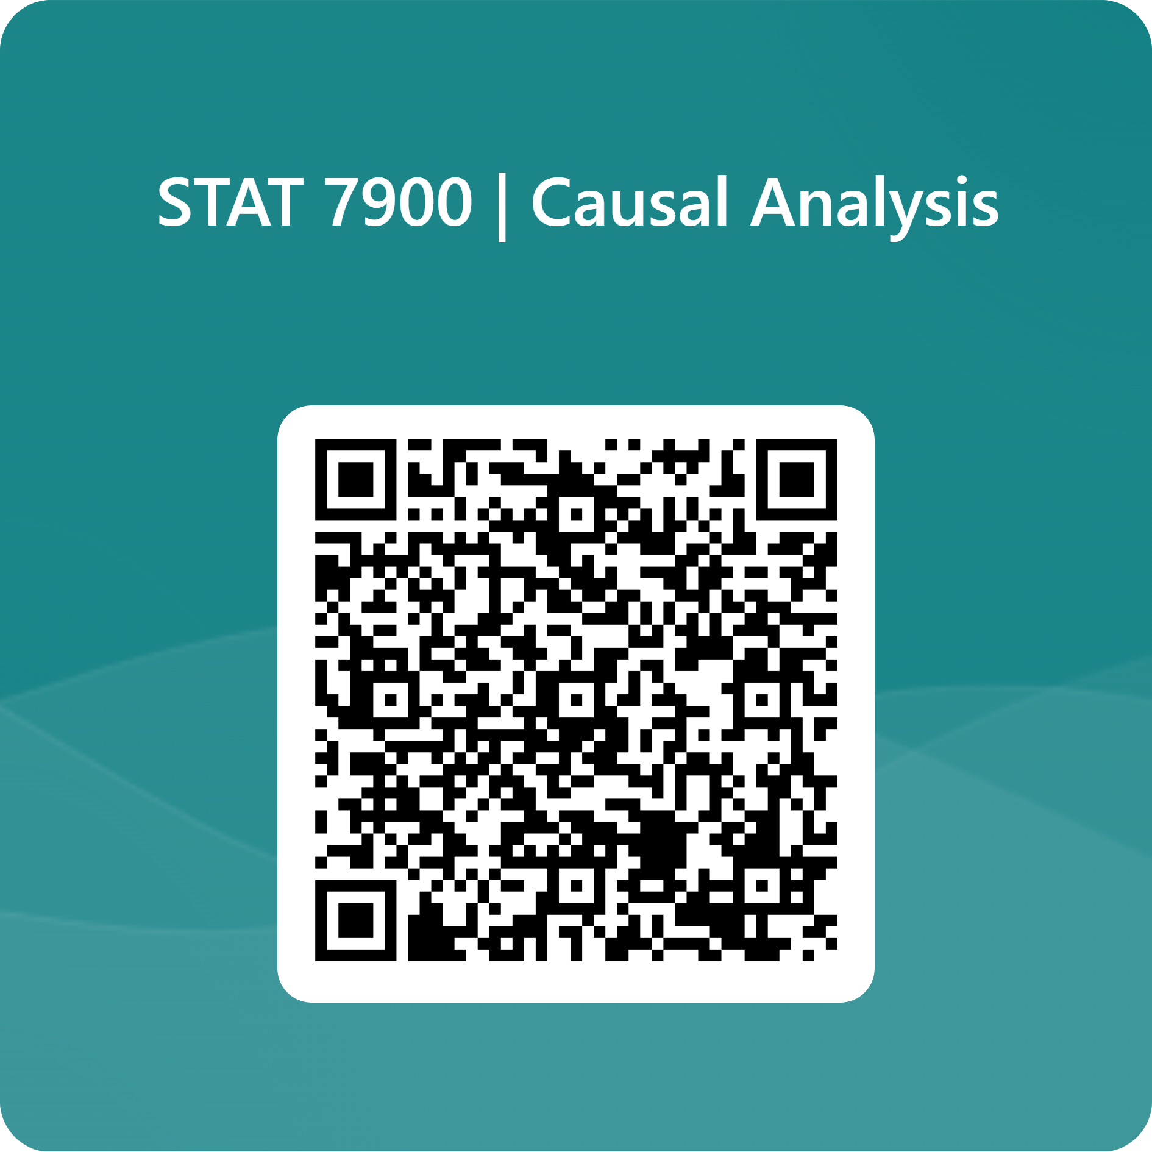

Slide 14
Why Do We Need Another HTE Method?
S / T / X learners
What is still difficult?
A different idea
Learn outcome models and/or imputed effects.
Result depends on the choice and quality of base learners.
Many modifiers, nonlinear interactions, sparse subgroups, and data-driven searches for where effects differ.
Build local treatment–control comparisons around people with similar X, using trees designed for HTE.
Causal forest is an alternative CATE estimator, not a required successor to S/T/X.

Slide 15
Ordinary vs Causal Trees: What Should a Split Find?
Ordinary prediction tree
Causal tree
Split on X to make outcomes Y easier to predict.
Example: baseline severity predicts risk well, even when treatment effect is constant.
Split on X when there is evidence that treatment effects differ across the resulting groups.
Example: biomarker status changes the treated-control contrast.
Strong predictor of Y $≠$ strong modifier of treatment effect

Slide 16
Ordinary Random Forest Is Not a Causal Forest
Ordinary random forest
Causal forest
Goal: predict Y accurately.
Splits reduce outcome prediction error.
A strong prognostic variable may dominate even if it does not modify treatment effect.
Goal: estimate heterogeneity in treatment effects.
Splits seek regions with different treatment effects.
Treatment and control information are compared within leaves.
Prediction heterogeneity $≠$treatment-effect heterogeneity

Slide 17
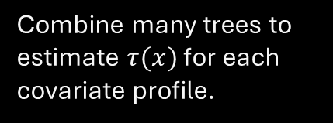
Causal Forest: Intuition
Grow many trees
Look for effect differences
Average locally
Prefer splits that reveal treatment-effect heterogeneity rather than outcome levels alone.
Combine many trees to estimate $τ(x)$ for each covariate profile.
Repeatedly partition covariate space into local neighborhoods.
Forest = adaptive local comparison + aggregation across many trees

Slide 18
Causal Forest: The Main Idea
1. Local groups
2. Local causal contrasts
3. Ensemble
Trees partition covariate space into neighborhoods of similar X.
Within neighborhoods, use observed treatment and outcome information to estimate effects.
Average information across many trees to produce a CATE estimate at x.
Unlike an ordinary forest, splitting is designed for treatment-effect heterogeneity.

Slide 19
Honest Trees: Choosing Splits
Without sample separation
Honest estimation
The same unusual outcomes can influence both the tree partition and the effect estimate.
This can exaggerate apparent heterogeneity.
Use one subsample to choose splits and another to estimate treatment effects in the selected leaves.
Reduces adaptive estimation bias.
Honesty helps with adaptive bias; it does not remove confounding or lack of overlap.

Slide 20
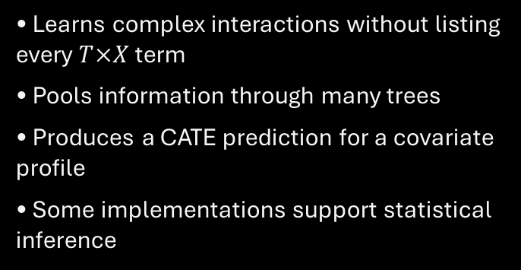
What Causal Forests Do and Do Not Guarantee
Useful features
Still required
• Learns complex interactions without listing every $T×X$ term
• Pools information through many trees
• Produces a CATE prediction for a covariate profile
• Some implementations support statistical inference
• A defensible causal design and adjustment set
• Adequate overlap and sample size
• Valid outcome and treatment coding
• Diagnostics and honest uncertainty reporting
A sophisticated algorithm does not identify a causal effect by itself.

Slide 21
R: Fit a Causal Forest with the LaLonde Data
R code
library(MatchIt)
library(grf)
data("lalonde", package = "MatchIt")
d <- lalonde
X <- model.matrix(
~ age + educ + race + married + nodegree + re74 + re75,
data = d)[, -1, drop = FALSE]
cf <- causal_forest(
X, Y = d$re78, W = d$treat, seed = 123
)
X: baseline covariate matrix
Y: 1978 earnings
W: training indicator
The forest estimates effects conditionally on X.
Requires package grf.

Slide 22
R: Fit a Causal Forest with the LaLonde Data
R code
cate_cf <- predict(cf)$predictions
summary(cate_cf)
new_person <- d[1, , drop = FALSE]
new_person$age <- 30
new_person$educ <- 12
new_person$re74 <- 5000
new_person$re75 <- 6000
# Build the same predictor matrix
X_new <- model.matrix(
~ age + educ + race + married + nodegree + re74 + re75,
data = new_person
)[, -1, drop = FALSE]
predict(cf, newdata = X_new)$predictions
How to use the fitted forest to get cate estimates

Slide 23
How to see how CATE changes with age?
R code
plot(
ages, tau_age,
type = "l",
lwd = 2,
xlab = "Age",
ylab = "Estimated CATE ($)",
main = "Causal Forest: Training Benefit by Age"
)
abline(h = 0, lty = 2)
# Use a typical worker as reference
X_age <- X[rep(1, 38), , drop = FALSE]
# Change only age
ages <- 18:55
X_age[, "age"] <- ages
# Predict CATE at each age
tau_age <- predict(cf, newdata = X_age)$predictions

Slide 24
What Does Variation in Predicted CATEs Mean?
Possible signal
Possible noise
Needed next
The causal effect really differs across baseline covariate profiles.
Small subgroups, model instability, or finite-sample variability create apparent differences.
Calibration, uncertainty, external or honest validation, and overlap checks.
Prediction variability is a hypothesis about HTE, not a completed validation.

Slide 25
Can We Trust the Heterogeneity?
Calibration
Ranking
Support + uncertainty
Are estimated effects systematically too small or too large?
Do high-predicted-benefit groups show larger treatment effects in independent data?
Are estimates based on adequate treatment overlap and enough information?
Evaluate the CATE model, not only its ability to predict the observed outcome.

Slide 26
Why In-Sample HTE Patterns Can Mislead
Discover + evaluate on the same data
Use independent evidence
The model can search for spurious groups.
Examining the same observations again may make those groups look more convincing.
Train on one set and evaluate HTE on held-out data.
Cross-fitting can use each observation for evaluation without fitting its prediction on itself.
Exploratory subgroup discovery should be distinguished from confirmatory evidence.

Slide 27
Cross-Fitting: The Basic Workflow
Fold A
Fold B
Repeat
Fit models using data outside Fold A.
Predict CATE for Fold A.
Fit models using data outside Fold B.
Predict CATE for Fold B.
Every evaluated person receives a prediction from a model that did not train on their outcome.
Cross-fitting limits overfitting; it does not fix unmeasured confounding.

Slide 28
CATE Calibration: Does the Magnitude Make Sense?
Example
What calibration checks
Model predicts effects near −2 for low-risk patients and −10 for high-risk patients.
In independent evaluation data, do estimated treatment contrasts align with those magnitudes?
Whether stronger predicted effects correspond to stronger causal contrasts.
Needs an appropriate causal estimator and uncertainty, not raw outcome comparisons.
CATE calibration $≠$ ordinary outcome-prediction calibration.

Slide 29
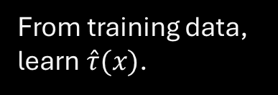
Ranking by Predicted Benefit
First
Second
Third
From training data, learn $\hat{τ}(x)$.
In held-out data, group units into low, medium, and high predicted benefit.
Estimate each group’s causal effect, with adjustment appropriate to the design.
Do not compare untreated outcomes with treated outcomes without a credible design.

Slide 30


Local Overlap: Some CATEs Are Harder to Learn
$$e(x) = P(T=1 | X=x)$$
At $e(x) ≈ 0.5$
At$e(x) ≈ 0.01$ or $0.99$
Treated and control observations are both reasonably represented nearby.
One treatment arm is rare; local counterfactual comparisons are weakly supported.
A forest cannot recover an unobserved treatment arm from modeling alone.

Slide 31
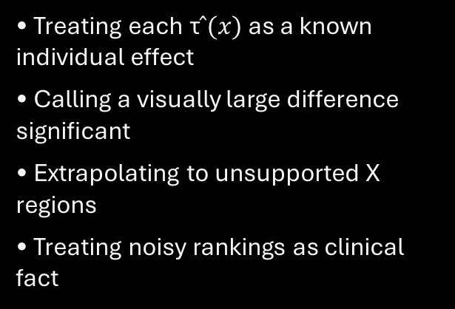
Uncertainty: Estimated CATE Not an Individual Truth
Report
Avoid
• Predicted treatment effects at relevant X
• Appropriate standard errors / intervals
• Uncertainty in subgroup differences
• Sample size and overlap diagnostics
• Treating each τ$̂(x)$ as a known individual effect
• Calling a visually large difference significant
• Extrapolating to unsupported X regions
• Treating noisy rankings as clinical fact
If intervals are wide, say the data are not informative enough about heterogeneity.

Slide 32
R: Useful Causal-Forest Diagnostics
R code
Important qualification
# Calibration diagnostic within grf
test_calibration(cf)
# Forest’s estimated average treatment effect
average_treatment_effect(cf)
# Treatment propensity estimated by forest
summary(cf$W.hat)
# Inspect CATE predictions
quantile(predict(cf)$predictions,
probs = c(.05, .25, .5, .75, .95))
test_calibration() is a model diagnostic, not external validation.
For a real HTE validation exercise, use independent/held-out comparisons and appropriate inference.

Slide 33
What Should Responsible HTE Results Include?
Design first
Method + diagnostics
Interpretation
Population and estimand
Treatment/outcome definitions
Measured confounders
Overlap assumptions
Model specification
Sample splitting / honesty
CATE plots and intervals
Calibration and stability
Magnitude and direction
Clinically/policy meaningful strata
Exploratory vs confirmatory
Unmeasured confounding caveat
Explain who benefits, how much, and how confidently—not just which algorithm won.

Slide 34
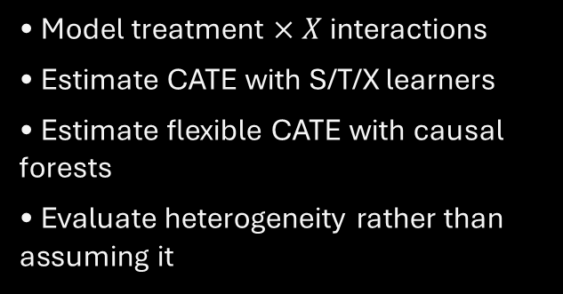
Final HTE Takeaways and the Next Causal Challenge
What we can now do
What remains unresolved
• Model treatment $× X$ interactions
• Estimate CATE with S/T/X learners
• Estimate flexible CATE with causal forests
• Evaluate heterogeneity rather than assuming it
All of these approaches require a defensible identification strategy.
What if treatment assignment depends on an important confounder U that was never measured?
Next: Unobserved Confounding and Sensitivity Analysis

Slide 35
A Concrete Reason to Worry: Missing Motivation
Example: job-training program
What the dataset records
Some participants enroll because they are especially motivated.
Motivation may also improve their earnings even without training.
Treatment, age, education, prior earnings, and later earnings.
But motivation was not recorded. Participants and nonparticipants can still differ.
Discussion: if we exactly balance age and prior earnings, is the comparison necessarily causal?

Slide 36
Estimation Is Not Identification
Estimation problem
Identification problem
Given an identified causal effect, how can we estimate it reliably?
Regression, IPW, AIPW, and forests address aspects of this problem.
Can observed outcomes reveal the causal effect at all?
If U affects both T and Y, adjusting only for measured X may not identify the effect.
A more powerful prediction algorithm cannot reconstruct an unobserved confounder automatically.

Slide 37
Challenge the Assumption
Question 1: What could go wrong?
Question 2: How fragile is the conclusion?
An unmeasured common cause U makes treated and control groups incomparable even after adjustment.
We will examine its causal diagram and possible bias.
Instead of assuming U has no influence, assess how strong hidden confounding would need to be to overturn a result.
Tools: E-values and Rosenbaum bounds.
Sensitivity analysis tests robustness to specified hidden bias; it does not eliminate the bias.

Slide 38
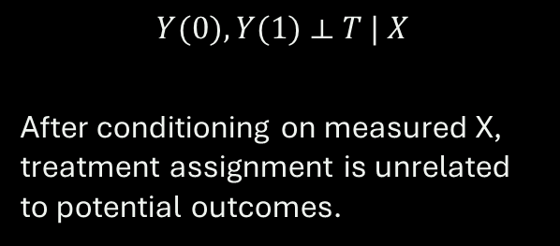
When the Ignorability Assumption Fails
What we have assumed
The difficult possibility
A variable U influences treatment and the outcome, but U was never recorded.
Conditioning on X may no longer remove confounding.
$$Y(0), Y(1) ⟂ T | X$$
After conditioning on measured X, treatment assignment is unrelated to potential outcomes.
More sophisticated estimation does not automatically repair failed identification.

Slide 39


A Hidden Common Cause: The DAG
Hidden U
Treatment T
Outcome Y
$U → T$: influences assignment
$U → Y$: predicts outcome
Open backdoor path: $T ← U → Y$

Slide 40
Example: Treatment Selection by Severity
Clinical setting
What goes wrong
Patients with more severe illness are more likely to receive an aggressive treatment.
Severity also increases the probability of a poor outcome.
Suppose the recorded data include age and sex, but not severity.
Comparing treated and untreated patients can make an effective therapy appear harmful.
The apparent treatment association mixes treatment effects with selection effects.

Slide 41
Why Familiar Estimators Cannot Fix Hidden U
Matching / IPW
g-computation / AIPW
Balance measured X; U can remain imbalanced.
Model outcome and treatment using measured X, not unobserved U.
S/T/X-learners
Causal forests
Flexible response models do not guarantee exchangeability.
Better CATE estimation does not identify effects without a valid design.
Bias from unmeasured confounding is an identification issue, not merely prediction error.

Slide 42

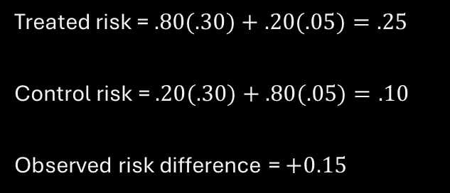
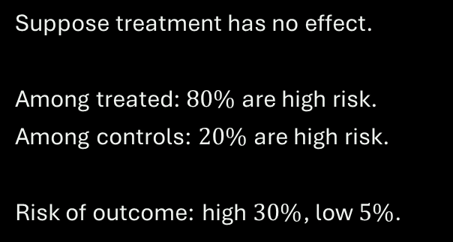
Numerical Illustration: A Spurious Effect
True causal effect $= 0$
Observed comparison
Suppose treatment has no effect.
Among treated: $80\%$are high risk.
Among controls: $20\%$ are high risk.
Risk of outcome: high $30\%$, low $5\%$.
Treated risk = $.80(.30)+.20(.05)=.25$
Control risk = $.20(.30)+.80(.05)=.10$
Observed risk difference = $+0.15$
A 15-percentage-point observed gap can exist even when treatment changes nothing.

Slide 43
What Is Sensitivity Analysis?
Conventional analysis
Sensitivity analysis
Estimate the treatment effect under assumptions about measured confounders and identification.
Vary assumptions about unmeasured confounding; examine how much conclusions would change.
It tests robustness to specified departures from assumptions; it does not verify them.

Slide 44
The Key Question: How Much Hidden Bias?
Weak U
Moderate U
Strong U
Small imbalance and weak outcome association.
Conclusion may persist.
Can attenuate the estimated effect.
Intervals may include null.
May overturn the estimated sign or statistical conclusion.
A tipping point is the strength of U at which the conclusion changes.

Slide 45
Different Sensitivity Tools Answer Different Questions
E-values
Rosenbaum bounds
How strongly must U relate to exposure and outcome (RR scale)?
How much hidden treatment-assignment bias can matched comparisons tolerate?
Quantitative bias analysis
Alternative identification
Choose confounder prevalence and outcome associations; compute corrected estimates.
Negative controls, IVs, and designs use additional assumptions and information.

Slide 46
E-Values: Intuition
A robustness summary on the risk-ratio scale
For an observed exposure–outcome risk ratio, the E-value summarizes the minimum association strength an unmeasured confounder would need with BOTH exposure and outcome, conditional on measured X, to explain away the association.
Larger E-values generally indicate greater robustness to this specific kind of confounding.
E-values do NOT measure how likely the hidden confounder is to exist.

Slide 47
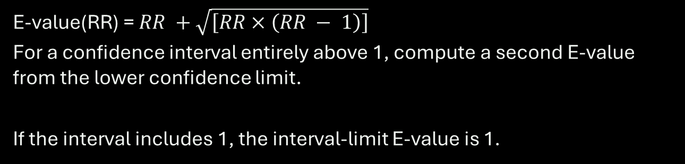
E-Value Formula: Risk Ratio Above 1
For $RR ≥ 1$
E-value(RR) = $RR +\sqrt{\left[RR × \left(RR − 1\right)\right]}$
For a confidence interval entirely above 1, compute a second E-value from the lower confidence limit.
If the interval includes 1, the interval-limit E-value is 1.
Use the RR scale. OR / HR and continuous outcomes require appropriate care or conversion.

Slide 48
Worked E-Value Example
Suppose a study reports
Calculate
Adjusted risk ratio = 2.00
95% confidence interval: [1.30, 3.00]
Outcome: a binary adverse event.
Point: 2 + √[2(2−1)] = 3.41
CI limit: 1.3 + √[1.3(.3)] = 1.92
E-values: point 3.41; CI 1.92
The CI-bound E-value is often more relevant to whether the result remains statistically distinguishable from null.

Slide 49
R Code: Compute E-Values Without Packages
evalue_rr <- function(rr) {
r <- ifelse(rr < 1, 1 / rr, rr)
r + sqrt(r * (r - 1))
}
rr <- 2.00
ci <- c(1.30, 3.00)
evalue_rr(rr) # 3.414
evalue_rr(ci[1]) # 1.924
Important
This code illustrates risk ratios and a CI above 1.
For ratios below 1, use the reciprocal and the CI limit nearest 1.
Not a substitute for judging U’s plausibility.

Slide 50
What E-Values Do, and Do Not Establish
Useful
Limitations
A compact numerical benchmark.
Can compare sensitivity against measured covariate associations.
Simple to calculate and report.
Cannot prove no confounding.
Does not establish the existence of a specific U.
Does not repair measurement error, selection bias, or model/design flaws.
Do not say “an E-value of 3.4 means the causal effect is proven.”

Slide 51
Rosenbaum Bounds: Motivation
After matching
Rosenbaum sensitivity analysis
Two patients appear comparable on observed X.
But one may still have a higher probability of receiving treatment because of unmeasured U.
Ask how large the hidden difference in treatment odds could be before a matched-study significance conclusion becomes fragile.
Rosenbaum bounds focus on sensitivity of matched comparisons to hidden assignment bias.

Slide 52
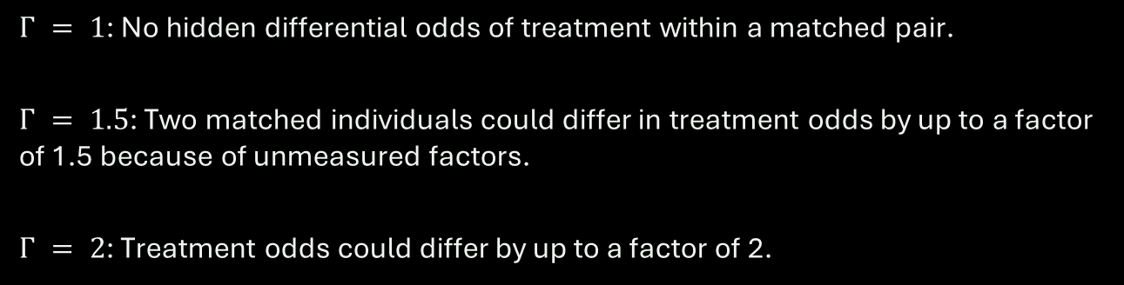
Rosenbaum’s $Γ$: Hidden Assignment Bias
Interpretation of Γ
$Γ = 1$: No hidden differential odds of treatment within a matched pair.
$Γ = 1.5$: Two matched individuals could differ in treatment odds by up to a factor of 1.5 because of unmeasured factors.
$Γ = 2$: Treatment odds could differ by up to a factor of 2.
$Γ$ is an odds-ratio bound for assignment, not an outcome risk ratio or bias percentage.

Slide 53
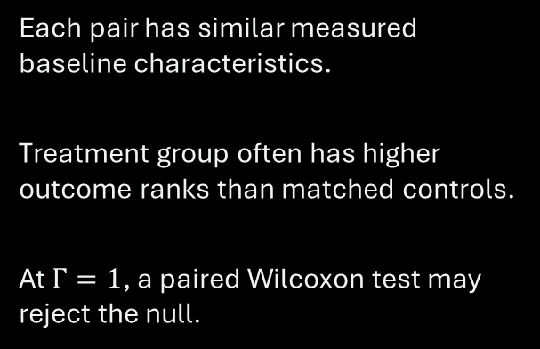
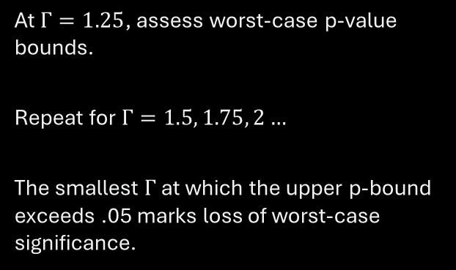
Worked Example: Matched Pairs and Γ
Imagine 30 matched pairs
Increase hidden bias
Each pair has similar measured baseline characteristics.
Treatment group often has higher outcome ranks than matched controls.
At $Γ=1$, a paired Wilcoxon test may reject the null.
At $Γ=1.25$, assess worst-case p-value bounds.
Repeat for $Γ=1.5, 1.75, 2…$
The smallest $Γ$ at which the upper p-bound exceeds .05 marks loss of worst-case significance.
Illustrative procedure; the tipping $Γ$ must be computed from the actual matched outcomes.

Slide 54
R Code: Rosenbaum Bounds for Matched Pairs
# install.packages("rbounds")
library(rbounds)
# Illustrative paired outcomes
trt <- c(12, 15, 11, 20, 18, 19,
16, 14, 13, 17)
ctrl <- c( 8, 10, 9, 12, 13, 14,
11, 10, 12, 13)
psens(trt, ctrl, Gamma = 2,
GammaInc = 0.25)
How to read output
Check upper and lower p-value bounds over Γ.
If upper bound becomes > .05, worst-case statistical significance is no longer guaranteed.
Input vectors must be correctly paired.

Slide 55
Putting the Results Into an Applied Report
What to report
What to conclude
Effect estimand, estimate, and uncertainty.
Measured adjustment set and balance diagnostics.
Chosen sensitivity method and assumptions.
Numerical sensitivity parameter(s).
Whether conclusions are robust within a stated range.
What plausible hidden confounders might look like.
Where conclusions change.
Avoid claims that the analysis rules out all bias.
Sensitivity analysis supplements, rather than replaces, research-design credibility.

Slide 56
Summary and Transition to Instrumental Variables
Today’s message
Next: Instrumental Variables
Unobserved U can invalidate exchangeability.
Sensitivity analysis examines robustness to specified hidden confounding.
E-values and Rosenbaum bounds answer different questions.
Can we identify an effect when exchangeability fails?
We will need new assumptions: relevance, exclusion, independence, and often monotonicity for LATE.
Sensitivity: “How fragile?” | IV: “Can a new design identify an effect?”

